Slide 1

The synodal path of the Church
Floriano Scioscia – International Confederation of the Apostolate of the Suffering, October 15-16, 2021

Slide 2
SYnod: Meaning
From Ancient Greek: σύνοδος (synodos), «assembly, meeting», from σῠν- (syn-, “with”) +‎ ὁδός (hodós, “way, path”)
Literally, «common path». Generically denotes an assembly or meeting to set a common path.
For the Catholic Church, the term refers specifically to the Synod of Bishops, organism created by S. Paul VI in 1965 within Vatican Council II (Motu proprio «Apostolica sollicitudo»).
Assembly of Bishops selected by Conferences of Bishops in the world, summoned by the Pope for consultation and collaboration on specific matters for the good of the universal Church.

Slide 3
The Synod of Bishops
Connected to an ancient and rich synodal tradition of the Church, and specially in Eastern Churches.
Visible sign of collegiality in the Church:
  communion of Bishops among themselves and with the Pontiff;
  pastoral concern of every Bishop, not only for its Diocesan Church, but also for the unichversal Church.
Perpetual institution, but working in temporary way, on a specific matter, whenever summoned by the Pope.
Three kinds of summons:
  Ordinary General Assembly: wide representation of Bishops from all over the world, for of ampia rappresentanza di Vescovi da tutto il mondo, per discernment on matters of general concern for the Church;
  Extraordinary General Assembly: narrower representation, for discernment on urgent matters;
  Special Assembly: representation of Bishops from a particular geografic zone.

Slide 4
Episcopalis Communio
2018 Apostolic constitution by Pope Francis, updating the process of the Synod of Bishops.
Goal: promote participation and joint responsibility in the whole People of God with ecclesial hierarchy at all levels.
Three-year, three-phase process:
2) Discussion
Bishops
1) Preparatory
3) Implementation
Base

Slide 5
Preparatory PhasE
Goal: consultation of the People of God on the matter chosen by the Pope for the Assembly of the Synod.
  Every Bishop consults believers in his Diocesan Church, according to participation organisms or other manners he judges as appropriate.
  Members of Institutes of consecrated life, Societies of apostolic life and Association of the Christian faithful are consulted as well.
  Institutes of Higher Education may be consulted, too.
Preparatory contributions are progressively collected, summarized and transmitted across intermediate levels of the Church hierarchy, up to the General Secretariat of the Synod
The General Secretariat of the Synod appoints a preparatory Commission, who prepare Working documents («instrumentum laboris») as an outline for the discussion.

Slide 6
Discussion Phase
The Pope and delegated Bishops gather in Rome for a preset period of time to discuss and discern on the matter of the Synod.
Assembly starts and ends with the celebration of the Eucharist presided over by the Pope.
The Assembly gathers in
  General Congregations (plenary sessions)
  Meetings of Small Groups (circuli minores) and Circoli minori and Study Commissions
The Assembly collects their conclusions in a Final Document, composed of several parts.
Bishops vote to approve each part.
Invited members with right to speak but without right to vote:
  Subject matter experts and Auditors
  Delegates of other Churches and Communities not in full communion with the Catholic Church.

Slide 7
Implementation phase
The final document is presented to the Pope, who decides whether to approve and publish it. In that case, it becomes part of the Magisterium of the Pope
Bishops oversee the implementation of the outcomes of the Assembly of the Synod.
Conferences of Bishops coordinate implementation on their territories with common initiatives.
To promote implementation, the General Secretariat of the Synod can:
  issue implementation documents, with mandate of the Pope;
  prepare studies and other initiatives;
  form a Commission of experts.

Slide 8
Synod 2021-2023
For a synodal Church: comMunion, participation and Mission
XVI Ordinary General Assembly of the Synod of Bishops.
A «Synod on Synods», requested by Pope Francis for a «fundamentally synodal Church» at all levels, from local to universal.
«The journey follows in the wake of the Church’s “renewal” proposed by the Second Vatican Council, as both a gift and a task: by journeying together and reflecting together on the journey that has been made, the Church will be able to learn through Her experience which processes can help Her to live communion, to achieve participation, to open Herself to mission. Our “journeying together” is, in fact, what most effectively enacts and manifests the nature of the Church as the pilgrim and missionary People of God» (see Preparatory document, 1).
Already in the 2015 Italian Church Conference in Florence, Pope Francis pointed at synodality as a path of renewal for the Church, and invited the Church in Italy to start a national synod.

Slide 9
Synod 2021-2023: the official logo
A large, majestic tree reaches for the sky. A sign of vitality and hope. It is the cross of Christ: it carries the Eucharist, which shines like the sun. The horizontal branches, opened like wings, suggest the Holy Spirit.
The People of God are not static: they are on the move, beginning from the tree-cross. These 15 silhouettes in multiple colors sum up our entire humanity in its diversity of origins and life situations.
There is no hierarchy, all these people are on the same footing: young, old, men, women, teenagers, children, lay people, religious, parents, couples, singles, healthy, disabled. The bishop and the nun are not in front of them, but among them. Quite naturally, children and then adolescents open their walk.

Slide 10
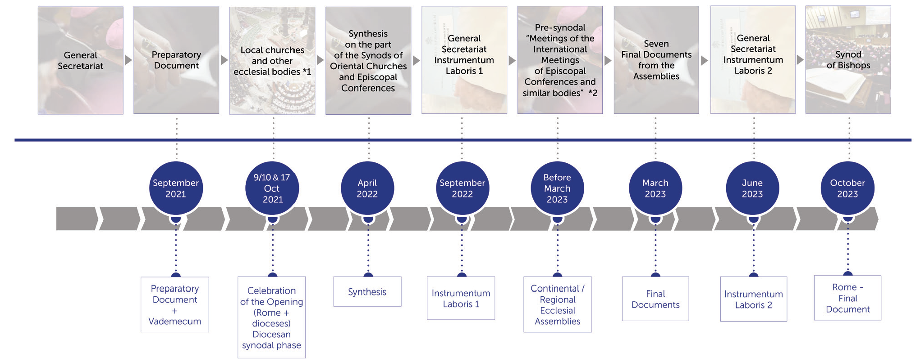
Roadmap 2021-2023

Slide 11
MaterialS
Working materials are available in several languages on the https://www.synod.va website:
  Vademecum
  Preparatory document
  Suggestions for reflecting and sharing
  Suggestions for celebrations
  …

